Slide 1

Building better dissemination systems for national development indicators
Phanom Pehn, Cambodia
21-25 April 2014

Slide 2
Cooperation & the way forward
Nampung Chirdchuepong
National Statistical office
Nampung.gs4@gmail.com

Slide 3
The Role of NSO (by Statistics Act 2007)
Statistics production (statistics & indicators)
Statistical services
Management of national statistical system
Censuses
- Population and
Housing Census
- Agricultural Census
- Business and Industry
Census
Surveys
- Economic
- Social
- Public opinion
Advice on statistical technique
Training/Study visit
- Statistics
- Computer programs
Collaboration in statistical matter
- Domestic
- International
Compile statistics / indicators
- from NSO
- from other agencies
Develop national statistical master plan
- develop fundamental
statistics of the country
for decision making
(official statistics)
Establish statistics development plan
- quality assessment
- statistical standard
(definition, classification
for occupation/industry/
education, ..)
Statistical Information Integration and Sharing
(develop a centralized system)
Produce basic information from
Notes:
3

Slide 4
The relation
Statistical Master Plan
statXchange
KNDI
 | 2009 | 2010 | 2011 | 2012 | 2013 | 2014 | ….
statXchange
Master Plan
KNDI

Slide 5

Thailand Statistical Master Plan: Principal Idea
Good Governance
Statistical Committee
Sectoral Statistics Sub-committees
(21 sub-committees)
Government Policy
Provincial Statistics committees
(76 committees)
Official Statistics & responsible agencies
MIS → DSS → EIS
3
Notes:
5
5
5

Slide 6
The Implementation of Thailand Statistical Master Plan 2011-2015
Cabinet approval, 28 Dec 2010
Cabinet approval, 3 May 2011
Committee on National Statistical System Management
(3 Major Stat.: Social, Economics, and Natural resources and environment)
Technical Advisory
Committee
Sectoral Statistical
Sub-committee
(21 sectors)
(Function Base)
Provincial Statistical
committee
(76 provinces/18 provincial clusters)
(Area Base)
Constructing the country statistical database from registered base data, survey/census data
- have official statistics; key statistics items in each sector with quality,
completeness and no duplication, host agency of official statistics will be
clearly identified
- all levels of administrators will have statistical data for decision making
4
Notes:
6
6
6

Slide 7
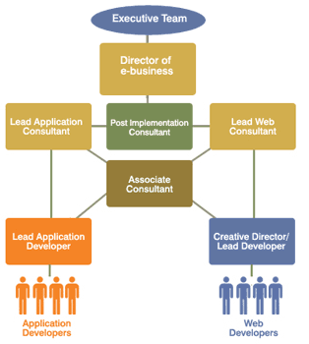
Implementing TSMP: Function Base Approach
Going on process …
Sectoral Committee on Statistics Data (21 sectors)
Sub-committee
Sector 1
Sub-committee
Sector 2
...
Sub-committee
Sector 21
OS of Population statistics sector
OS of Labor statistics sector
...
OS of Environmental and Resources statistics sector
Data link / integrate / share
Prime Minister Operation Center: (PMOC)
Can be analyzed
and found its relation
Can be presented in an easy format
(table / graph / map)
7
Notes:
7
7
7

Slide 8
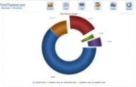
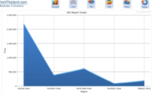
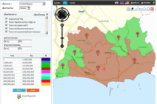
Implementing TSMP: Function Base Approach (cont’d)
Going on process …
Data link / integrate / share
Can be analyzed
and found its relation
Can be presented in an easy format
(table / graph / map)
1. Mind Map
2. Function ; Y = a + bx₁+ cx₂ + …
Evidence base for decision making
8
Notes:
8

Slide 9
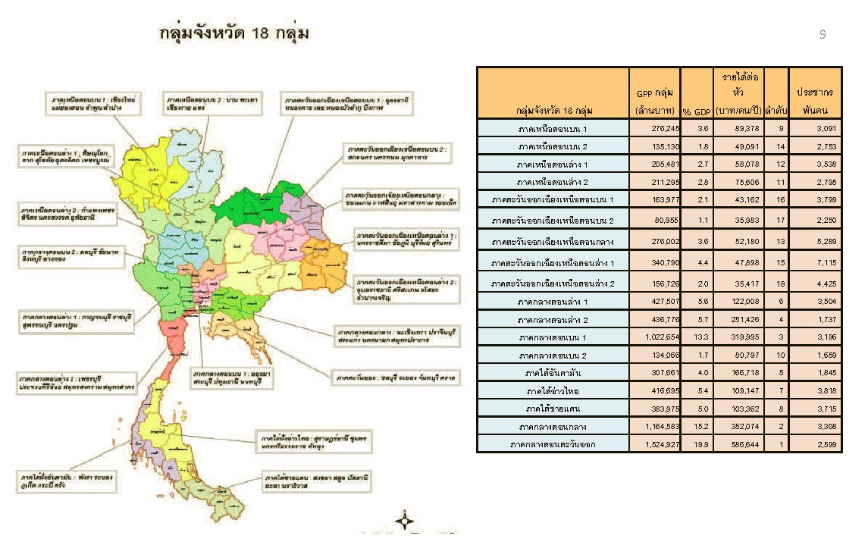
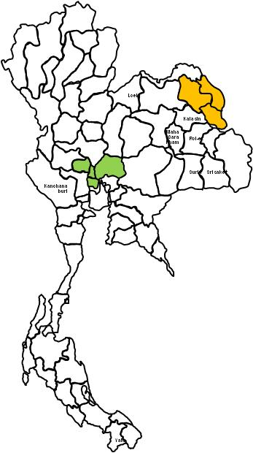
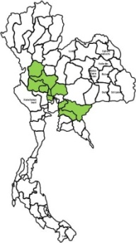
โครงการพัฒนาข้อมูลสถิติและสารสนเทศระดับพื้นที่ 76 จังหวัด/18 กลุ่มจังหวัด (พ.ศ.2557)
Area base approach (76 provinces and 18 groups
สำนักงานสถิติได้ดำเนินการพัฒนาระบบสถิติเชิงพื้นที่
โดยให้ความสำคัญในการเชื่อมโยงยุทธศาสตร์
ของประเทศสู่ยุทธศาสตร์เชิงพื้นที่ของกลุ่มจังหวัด
นำร่องตั้งแต่ พ.ศ. 2555-2526
2557
พัฒนาข้อมูลสถิติและสารสนเทศระดับพื้นที่
76 จังหวัด/18 กลุ่มจังหวัด
2556 นำร่อง
2 กลุ่มจังหวัด
2555 นำร่อง 10 จังหวัด
9

Slide 10
Data exchange: StatXchange
using StatXML
Implemented since …
Some limitations with StatXML …
M of ICT
M of Finance
M of Industrial
Office of the Prime Minister
M of Culture
M of Social Welfare
M of Interior
M of Energy
M of Commerce
M of agriculture & co-op
M of Natural Resource &
environment
StatXML
Ministry of Defense
Ministry of Labour
M of Public Health
M of Foreign Affair
M of Traqsportation
M of Tourism & sport
Ministry of Education
M of Science &
Technology
UDDI
NIC
11

Slide 11

Key National Development Indicators
V.S.
Statistical Master Plan

Slide 12






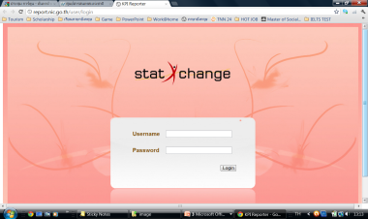


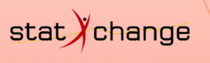
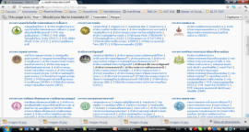


Project on National Development Indicators
Workshop to selected indicators framework
- Economic
- Social
- Environment
Project approved
Study indicators (Master Plan, web site, Questionnaires etc)
Sign in Cooperation agreement
Working group
-Set up working group
-List of Indicators with metadata
- release calendar
- responsible agency
- time frame
Training / workshop
to officers
Report on National development indicators
Metadata Handbook
Report on quality assessment
Report on meeting / seminar /training
- hand book for user
Hand book for administrator
Network meeting
Web site / e-book

Slide 13
Project on National Development Indicators
Workshop to selected indicators framework
- Economic
- Social
- Environment
Project approved
Study indicators (Master Plan, web site, Questionnaires etc)
Sign in Cooperation agreement
Working group
-Set up working group
-List of Indicators with metadata
- release calendar
- responsible agency
- time frame
Training / workshop
to officers
Report on National development indicators
Metadata Handbook
Report on quality assessment
Report on meeting / seminar /training
- hand book for user
Hand book for administrator
Network meeting
Web site / e-book

Slide 14

Problem encounter
Cooperation
Data Collection
Funding approach
Customization
Training issues

Slide 15
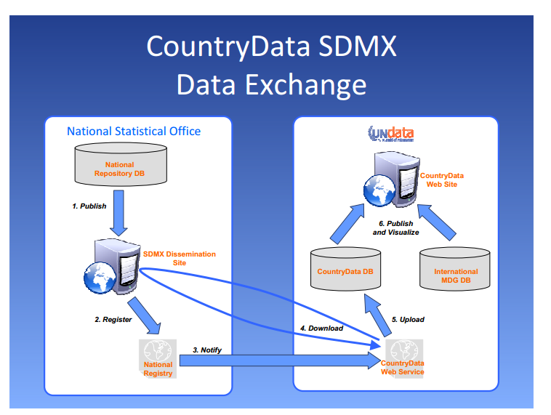

Slide 16

The way forward

Slide 17
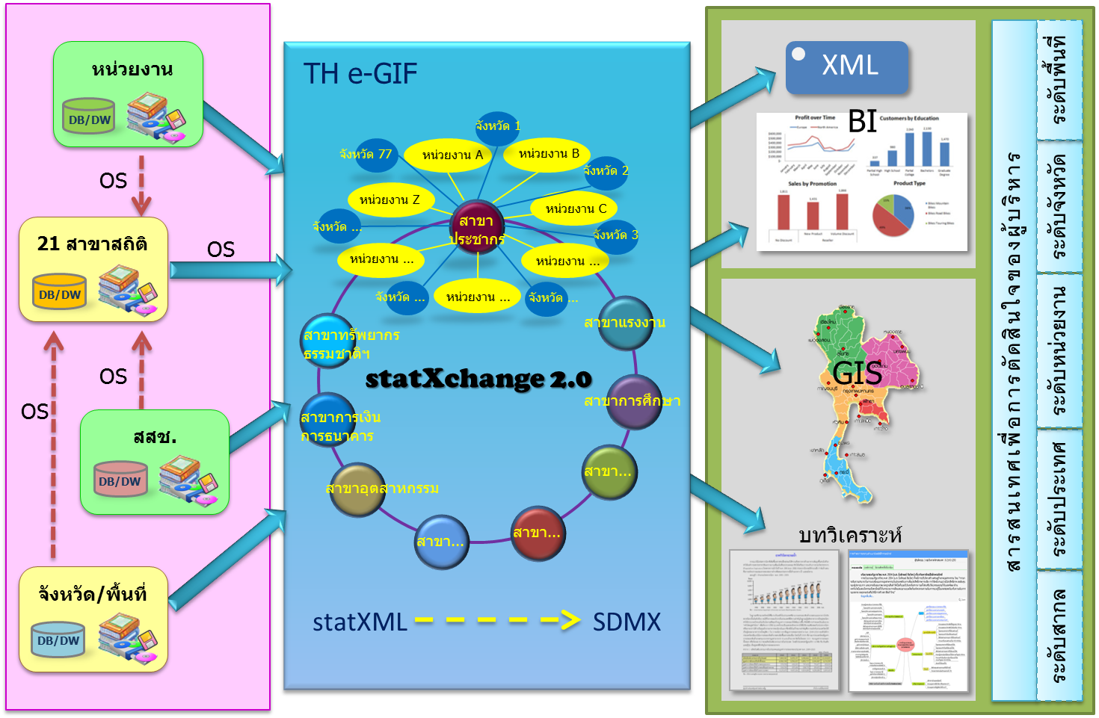

Data Integration – the way to do
Decision information for administrator
Area
Agency
Province
21 sectors
Agency
NSO
National
Reports
Province/area
International

Slide 18
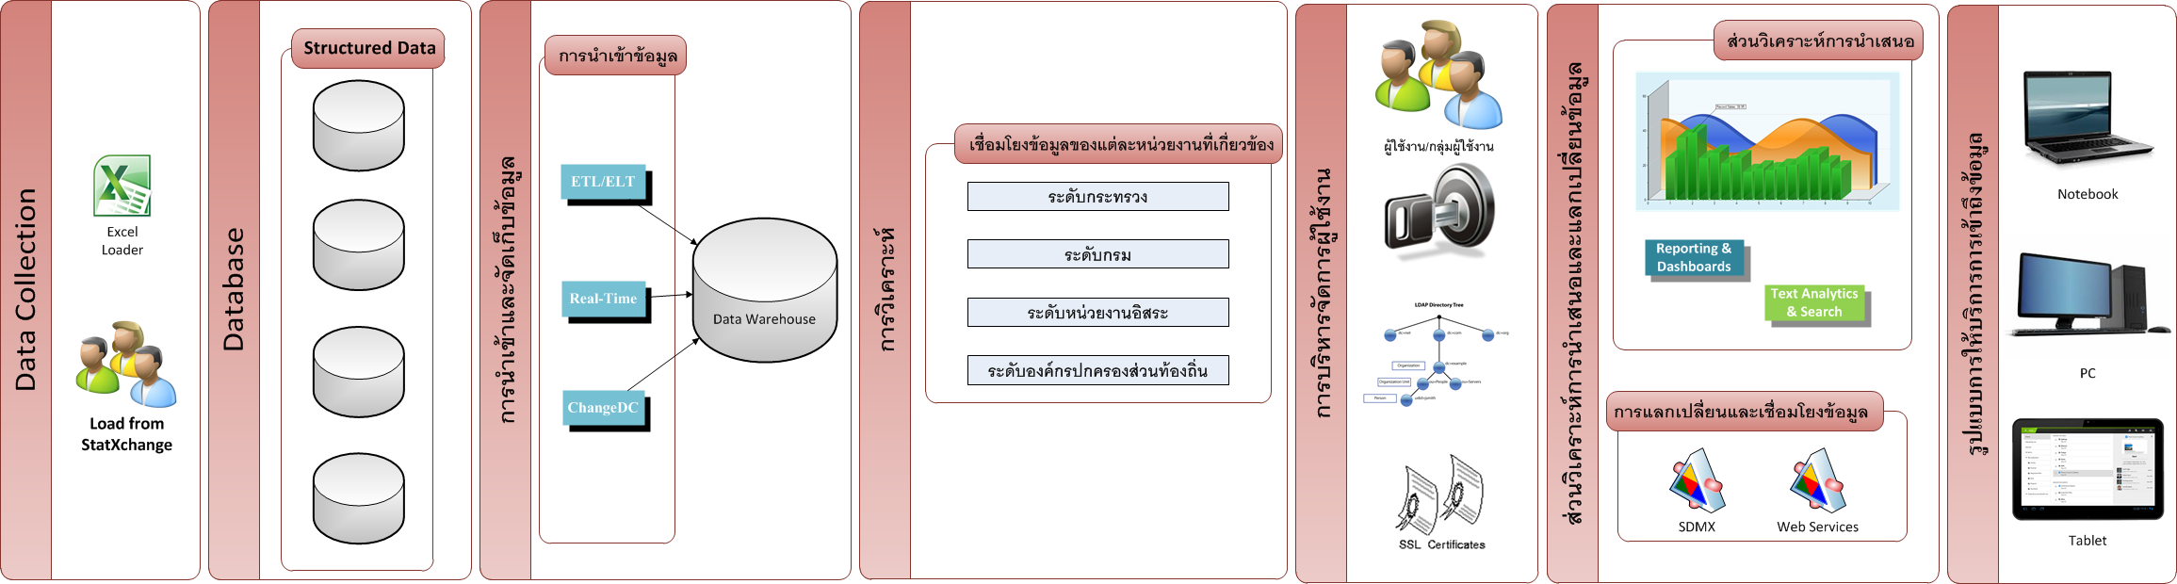
System Architect

Slide 19

Slow Roasted
Points of interest
Thank you

